Slide 1

Stephen Goodridge, Clark LaChance, Nick Pease, Aidan Bradley, Joe Gallant

Slide 2
Description
Web-based social networking service
https://www.chatma.ps/
Connect with others in your local geographical area
Features an interactive map showing general location relative to other users
Open chat rooms to start public conversations based on specific topics
Registered users may also create their own chat room
Create topics of interest for others to view or join
Features private chats for small groups to join and interact with
(i.e. friends only chat)
Our aim is community engagement, meaningful interactions, and a new way to meet others

Slide 3
Main Features
Chat function
Designed for users to be able to communicate with each other using chat rooms based on mutual interests
Map function
A map with a marker showing you and your friend’s general location
Also displays relative location of nearby chat rooms
Location Services
The user’s location is updated in real-time to facilitate conversations between nearby users

Slide 4
Comparable Apps
YikYak
Location-based with a forum-like structure
ChatMaps is concerned with real time chatting
Anonymous
ChatMaps implements user profiles
Omegle (and equivalents)
Anonymous chatting, with optional topics
ChatMaps is created for campuses or other metropolitan areas, location focus
Friends list feature
Snapchat
Very popular chatting platform, with location features
ChatMaps rooms feature allows users to meet strangers

Slide 5
User Stories
As a registered user, I want to be able to create my own chat room to meet people of similar interests.
Main feature, creation of chat rooms is a required ability for the user base
As a registered user, I want to be able to add other users so that I can reach out to them in the future.
Making new friends is a key goal of this service
As a registered user, I want to be able to send direct messages to other users so that I can chat with them in private.
Private messages will be a separate implementation to the chat room feature

Slide 6
User Stories (cont.)
As a registered user, I want to be able to visually see how big a chat room is so that I can avoid busy chat rooms.
The map will display nearby chat rooms and vary them in size
The map will have several features to facilitate communication
As a registered user, I want to be able to view who’s online so that I know who I can chat with.
Online and offline functionality
Intent is to allow users to set visibility to offline (separate user story)

Slide 7
Safety
User’s exact location will not be publicly available
ChatMaps will only show exact location to current friends if the user grants permission to do so
When creating a public chat room, the chat room will be placed randomly (nearby) on the interactive map for others around your area to join

Slide 8

Home Page

Slide 9
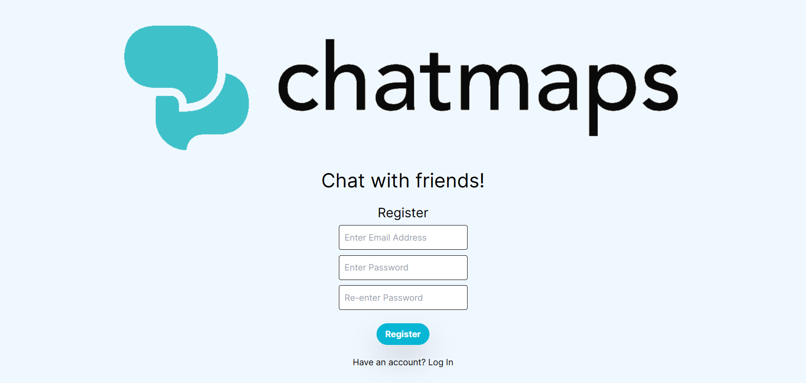
Register Page

Slide 10
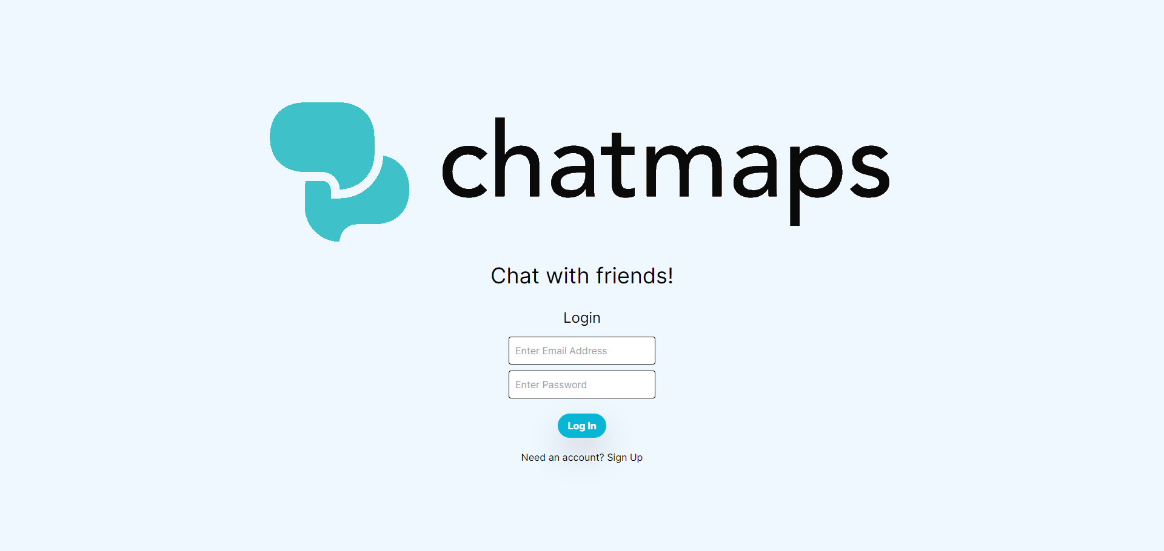
Login Page

Slide 11
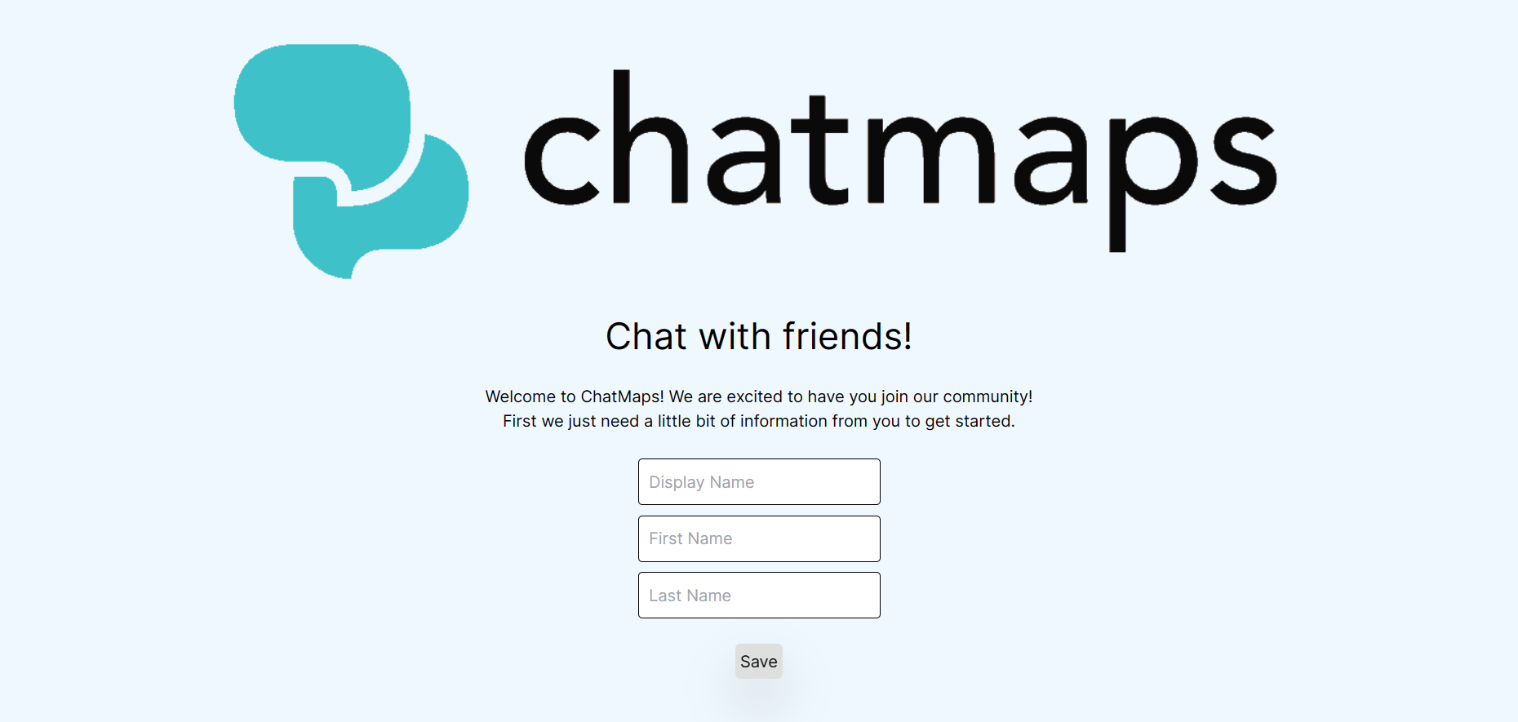
Onboarding Page

Slide 12
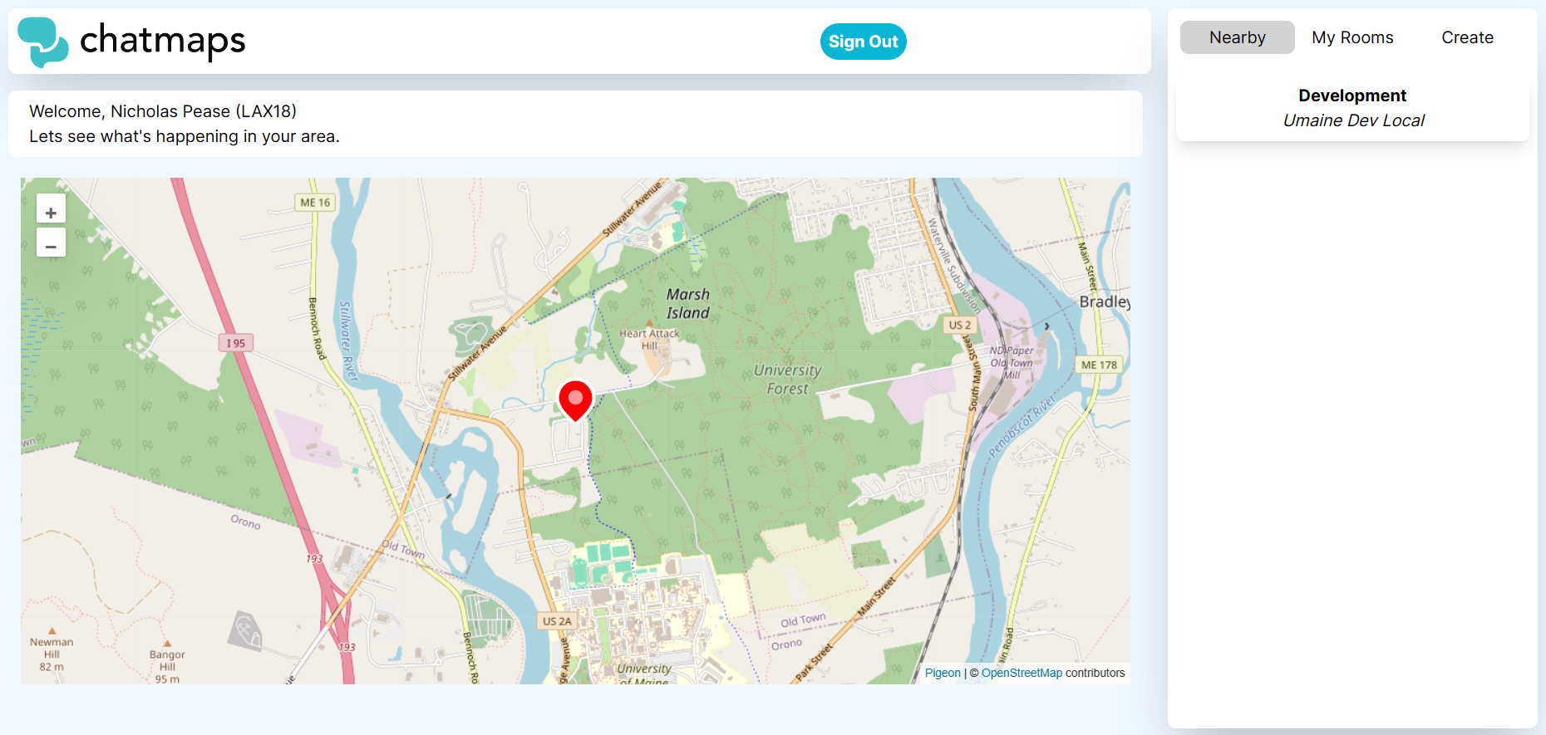
App Page

Slide 13
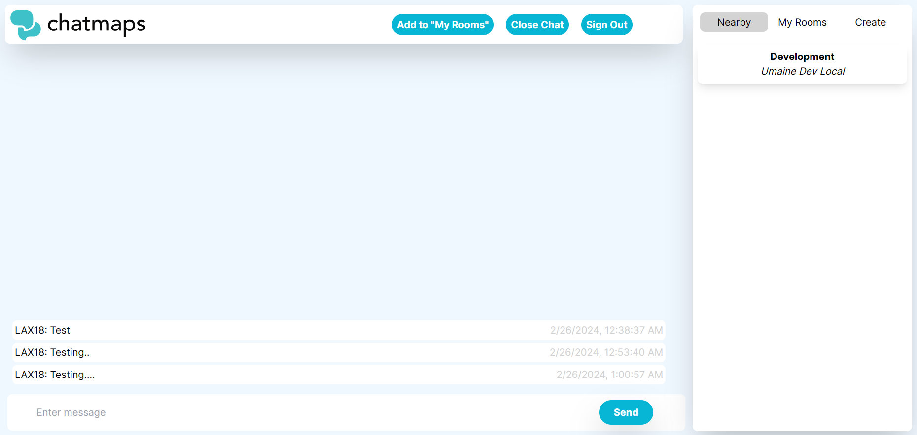
Chat Page

Slide 14
End Product

Slide 15
Questions?

